Slide 1
The Powerflow Module
This section will introduce you to the distribution powerflow simulator.

Slide 2
Powerflow Overview
Powerflow is the fundamental power system analysis tool.
Given the voltage of the generators and the load on the system powerflow determines voltage magnitude and angle, at all points on the system.
This information then allows for the calculation of line currents and power throughout the system.

Slide 3
Powerflow Overview
Transmission Systems
  Powerflow was originally limited to the transmission system.
  Many assumptions were made in the early developments of transmission power flow. e.g., only positive sequence.
Distribution Systems
  Powerflow simulations were not originally performed since stability and voltage sag issues were minimal.
  Was initially based on simple circuit equivalents.
  Sequential components were used, but found to be inappropriate.
  Recent work has focused on more complete modeling.

Slide 4
Distribution System Modeling
Traditionally the majority of analysis has been performed at the transmission level.
Only within the past 20 years has distribution level analysis received significant attention.
Many of the emerging technologies are designed to operate at the distribution level.

Slide 5
Distribution System Modeling (II)
The modeling of distribution equipment is similar to transmission modeling, but with more detail.
Loads are unbalanced on a distribution system.
Single and double phase lines exist.
Often distribution systems are radial.
The R/X values of a distribution system are much higher.

Slide 6
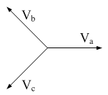

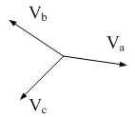

What Does Unbalanced Mean?
The voltage at the source is balanced:
The voltages down stream are unbalanced:

Slide 7
Types of Distribution System Equipment
Overhead lines
Underground cables
Transformers
Voltage regulators
Shunt capacitors
Other not included here include switches, reclosers, fuses, and lightning protection.

Slide 8
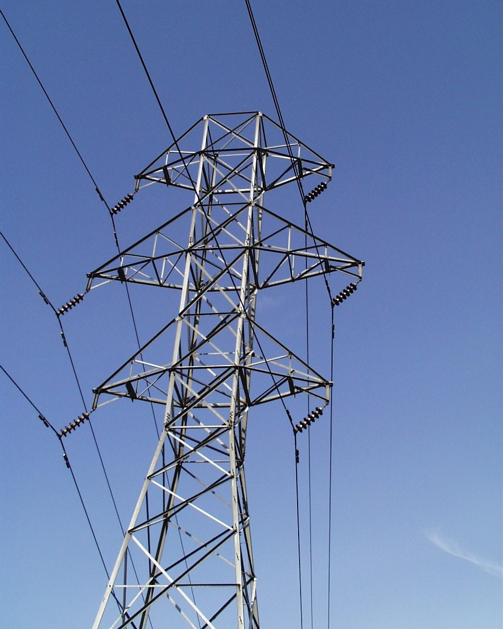
Transmission System

Slide 9
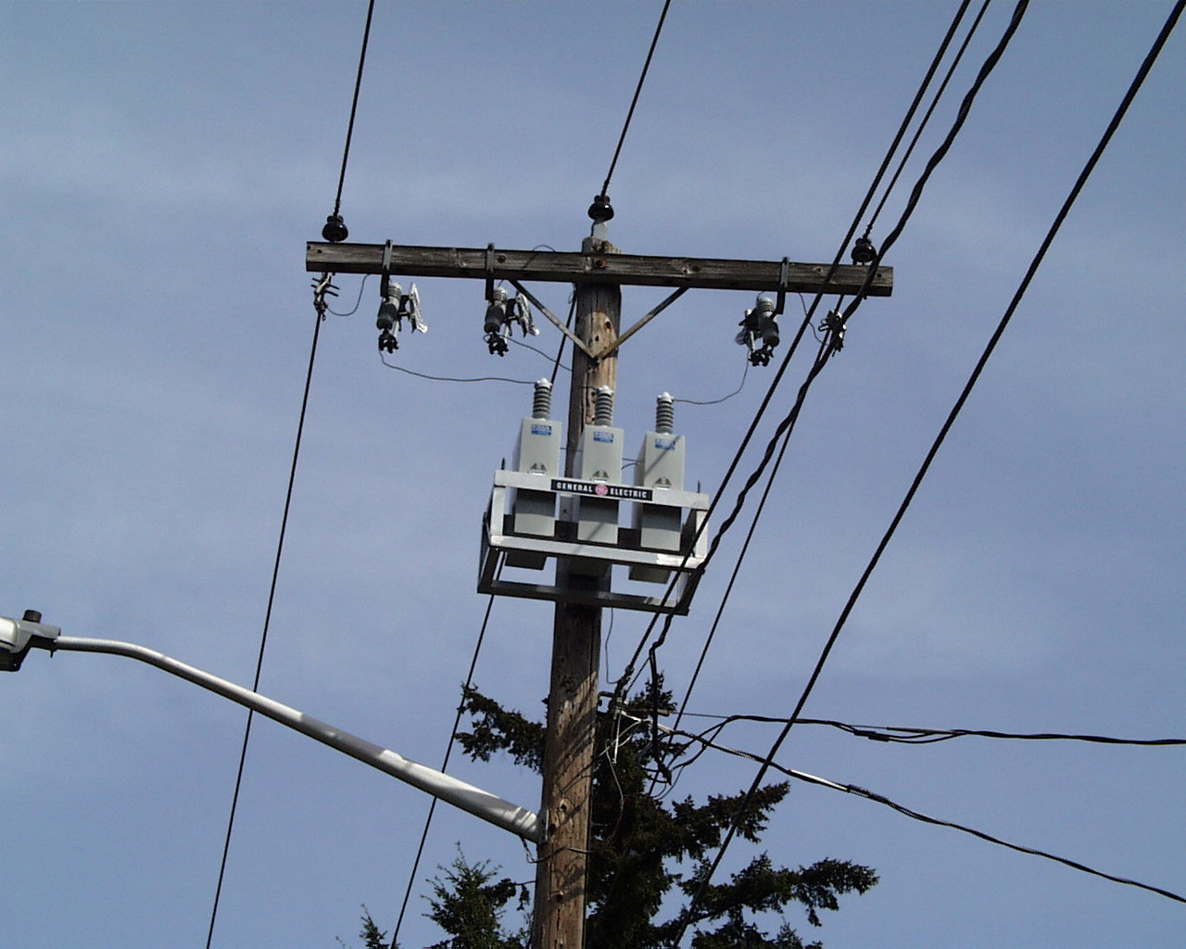
Distribution System

Slide 10
System Representations
Positive Sequence
Three-phase
System is assumed to be three-phase balanced.
Single-phase equivalent models are used.
Each phase, including neutral, is explicitly modeled.
Electromagnetic coupling between phases is included.
This allows for more accurate modeling including:
  Split-phase systems
  Single-phase loads
  Two-phase loads

Slide 11
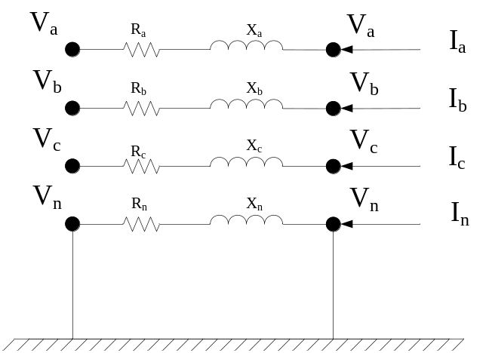




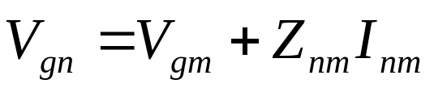

Modeling comparisons
Positive Sequence
Unbalanced
+
-

Slide 12

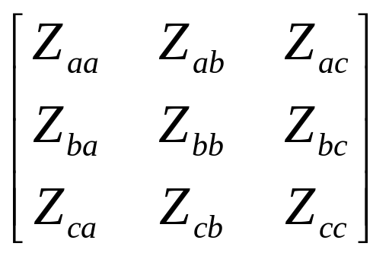
Three-phase Unbalanced
a
2.5'
b
4.5'
c
3.0'
4.0'
n
24.0'
Phase Conductor: 336,400 26/7
GMR = 0.0244 ft., Resistance = 0.306 Ω/mile, Diameter = 0.721 inch
Neutral Conductor: 4/0 6/1 ACSR
GMR = 0.00814 ft., Resistance = 0.592 Ω/mile, Diameter = 0.563 inch
Physical System
Parameterized Values
Values for Numeric Simulation

Slide 13
Overhead Line Code
Object Code
Configuration Code
object line_configuration {
name line_config_603;
conductor_B overhead_line_conductor_6030;
conductor_C overhead_line_conductor_6030;
conductor_N overhead_line_conductor_6030;
spacing line_spacing_505603;
}
// Phase Conductor for 603, 604, 605: 1/0 ACSR
object overhead_line_conductor {
name overhead_line_conductor_6030;
geometric_mean_radius 0.004460;
resistance 1.120000;
}
object line_spacing {
name line_spacing_505603;
distance_BC 7.0 ft;
distance_CN 5.657 ft;
distance_BN 5.0 ft;
}
object overhead_line {
phases "BCN";
name ohl_632-645;
from node_632;
to load_645;
length 500 ft;
configuration line_configuration_603;
}
B
C
N

Slide 14
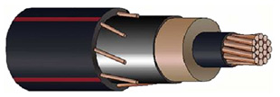
Underground Cables
Power conductors
Ground conductors

Slide 15
Underground Cable Code
Object Code
Configuration Code
object line_configuration {
name underground_line_configuration_607;
conductor_A underground_line_conductor_6070;
conductor_N underground_line_conductor_6070;
spacing line_spacing_520;
}
// Phase Conductor for 607: 1/0 AA,TS N: 1/0 Cu
object underground_line_conductor {
name underground_line_conductor_6070;
outer_diameter 1.060000;
conductor_gmr 0.011100;
conductor_diameter 0.368000;
conductor_resistance 0.970000;
neutral_gmr 0.011100;
neutral_resistance 0.970000;
neutral_diameter 0.0640837;
neutral_strands 6.000000;
shield_gmr 0.000000;
shield_resistance 0.000000;
}
object line_spacing {
name line_spacing_520;
distance_AN 0.0833 ft;
}
object underground_line {
phases "AN";
name ugl684-652;
from node_684;
to load-652;
length 800;
configuration line_configuration_607;
}

Slide 16
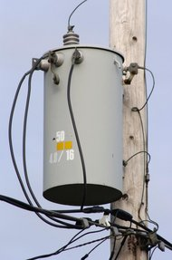
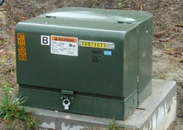
Service Transformers

Slide 17
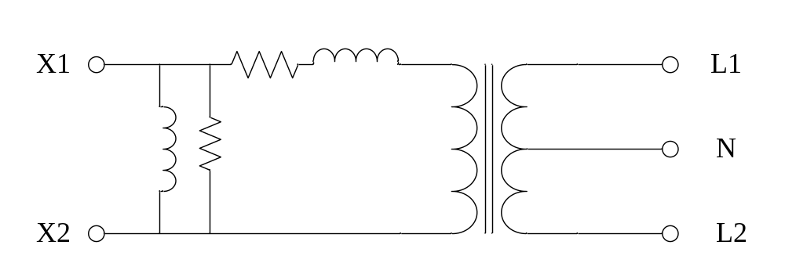
Service Transformer Model
120V
7,200V
240V
120V

Slide 18
Transformer Code
Object Code
Configuration Code
object transformer {
groupid Distribution_Trans;
configuration tc100100B;
name f5_T21400253B;
from f5_L2691959;
to f5_X2691959B;
nominal_voltage 7200;
phases BS;
}
object transformer_configuration {
name tc100100B;
connect_type SINGLE_PHASE_CENTER_TAPPED;
install_type POLETOP;
primary_voltage 7200.0;
secondary_voltage 120.0;
power_rating 100.0;
powerB_rating 100.0;
impedance 0.006+0.0136j;
// ↓Only used in Wye-Wye and CTTF
impedance1 0.012+0.0204j;
impedance2 0.012+0.0204j;
shunt_impedance 259200+103680j;
}

Slide 19
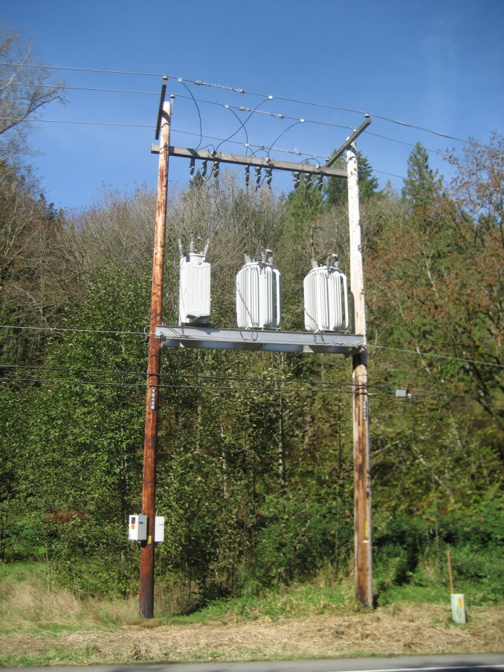
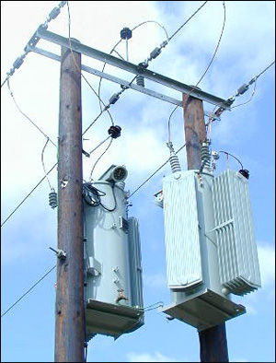
Voltage Regulators
Voltage regulators are used to adjust the voltage on a system in order to compensate for heavy (or light) loading which can result in a voltage drop (or rise).

Slide 20
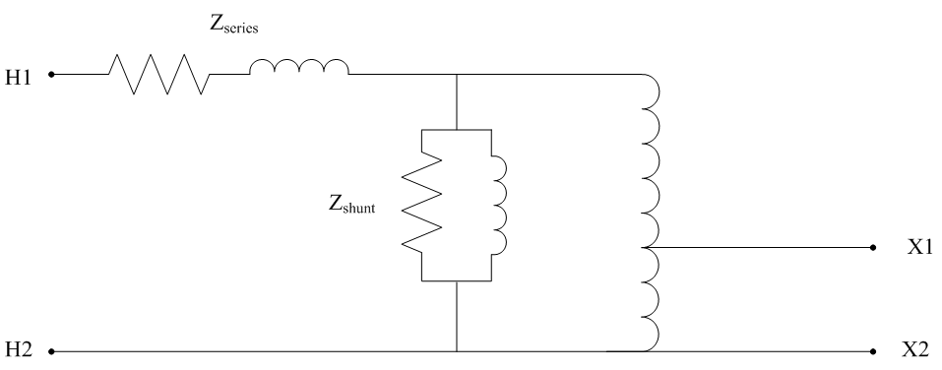
Voltage Regulators
Two winding auto transformers with a variable tap ratio.
Note: Voltage regulators in GridLAB-D are represented as ideal transformers (no losses).

Slide 21
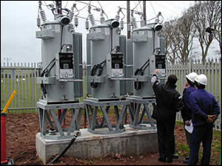
Voltage Regulator Code
Object Code
Configuration Code
object regulator_configuration {
name regulator_configuration_15;
connect_type WYE_WYE;
band_center 120.000;
band_width 2.0;
time_delay 30.0;
raise_taps 16;
lower_taps 16;
current_transducer_ratio 700;
power_transducer_ratio 20;
compensator_r_setting_A 3.0;
compensator_x_setting_A 7.5;
compensator_r_setting_B 3.0;
compensator_x_setting_B 7.5;
compensator_r_setting_C 3.0;
compensator_x_setting_C 7.5;
CT_phase "ABC";
PT_phase "ABC";
regulation 0.10;
Type A;
tap_pos_A 7;
tap_pos_B 7;
tap_pos_C 7;
Control MANUAL; // OUTPUT_VOLTAGE, // LINE_DROP_COMP or REMOTE NODE
}
object regulator {
name reg1501491;
phases "ABC";
from node_150;
to node_1491;
configuration regulator_configuration_15;
}

Slide 22
Shunt Capacitors

Slide 23
Capacitor Code
Object Code
Control modes available: MANUAL, VOLT, VAR, VARVOLT and CURRENT
pt_phase determines the phases to monitor for controls
nominal_voltage determines the impedance value
control_level may also be BANK
lockout_time allows minimum time between operations
remote_sense and remote_sense_B may be used for remote sensing operations
object capacitor {
phases ABCN;
name CAP1;
pt_phase ABCN;
parent 675;
phases_connected ABCN;
control VOLT;
voltage_set_high 2700.0;
voltage_set_low 2250.0;
capacitor_A 0.10 MVAr;
capacitor_B 0.10 MVAr;
capacitor_C 0.10 MVAr;
control_level INDIVIDUAL;
time_delay 300.0;
dwell_time 0.0;
switchA CLOSED;
switchB CLOSED;
switchC CLOSED;
nominal_voltage 2401.7771;
}

Slide 24
End Use Load Modeling
The primary purpose of an electricity distribution system is to supply the end use loads.
End use loads can be modeled in a variety of ways depending on the purpose.
  Time-invariant load models (ZIP Models)
  Time-variant load models
  Physical load models
  Multi-state physical load models
Note: Most of the loads in GridLAB-D are represented in the residential module, but the basic theory is described here.

Slide 25
Time-invariant load models
These load models are used for static single solution power flow calculations.
They are generally used for capacity planning studies where only the peak load is examined.
This is the traditional ZIP load model.

Slide 26
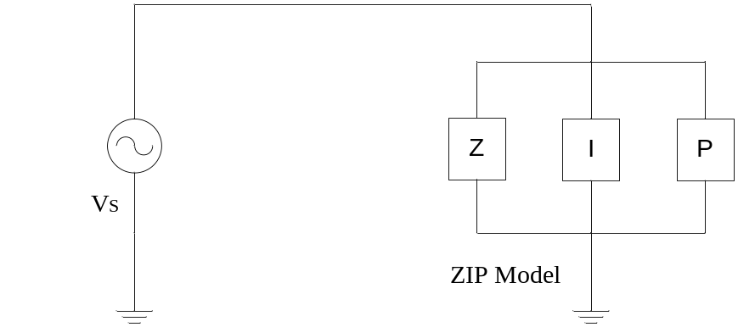
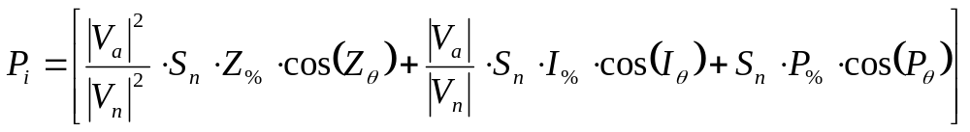
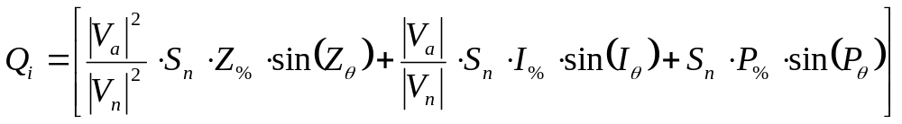

ZIP Load Model

Slide 27
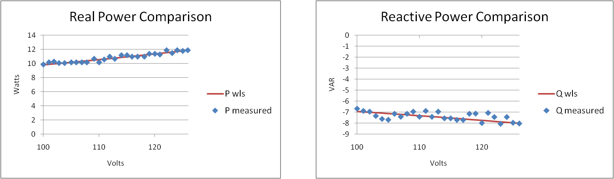
ZIP Load Model for 13W CFL
 | ZIP Values
 | Z-% | I-% | P-% | Z-pf | I- pf | P-pf
CFL-13W | 40.85% | 0.67% | 58.49% | -0.88 | 0.42 | -0.78

Slide 28
Time-variant load models
These are sometimes referred to as load profiles.
They can be fixed power values or time-variant ZIP models where ZIP coefficients change with time.
Often this information comes from measured data and is an aggregated value.

Slide 29
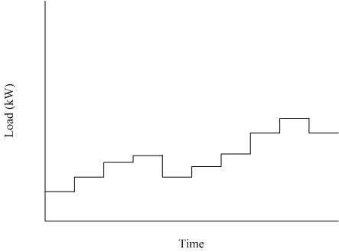
Example Load Profile

Slide 30
ZIP Load Code
Object Code
Schedule Code
object ZIPload {
groupid plugload;
base_power plug1*2.828958; power_fraction 0.100000; impedance_fraction 0.800000; current_fraction 0.100000; power_pf 0.950000; current_pf 0.950000; impedance_pf 0.950000;
};
schedule plug1 {
0-23 0 * * * 0.1605;
24-59 0 * * * 0.1381;
0-30 1 * * * 0.1297;
31-59 1 * * * 0.1289;
0-34 2 * * * 0.1254;
35-59 2 * * * 0.1301;
0-29 3 * * * 0.1255;
30-59 3 * * * 0.1276;
0-18 4 * * * 0.1292;
19-44 4 * * * 0.1399;
45-59 4 * * * 0.1422;
0-14 5 * * * 0.1438;
15-35 5 * * * 0.1621;
36-59 5 * * * 0.1806;
0-14 6 * * * 0.1981;
…

Slide 31
Physical Load Models
Physical load models are based on a physical process.
Processes can include: HVAC, energy storage, and thermal processes.
Time-variant in nature.
Can be significantly more complicated than ZIP models.
Provide the detail necessary to examine the actual behavior of end use loads.

Slide 32
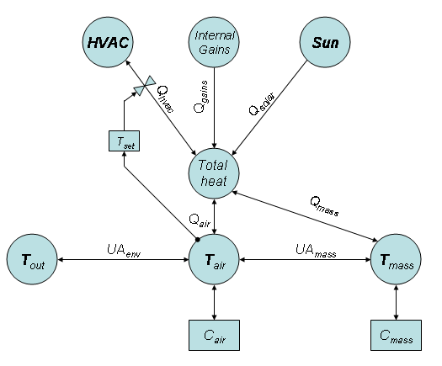
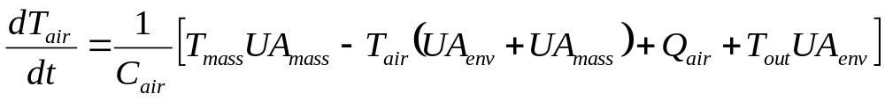
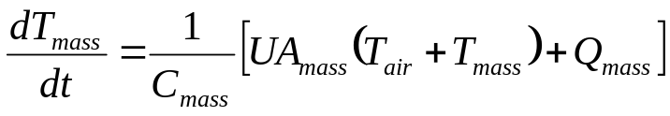
Physical Load Model – Residential HVAC System HVAC

Slide 33
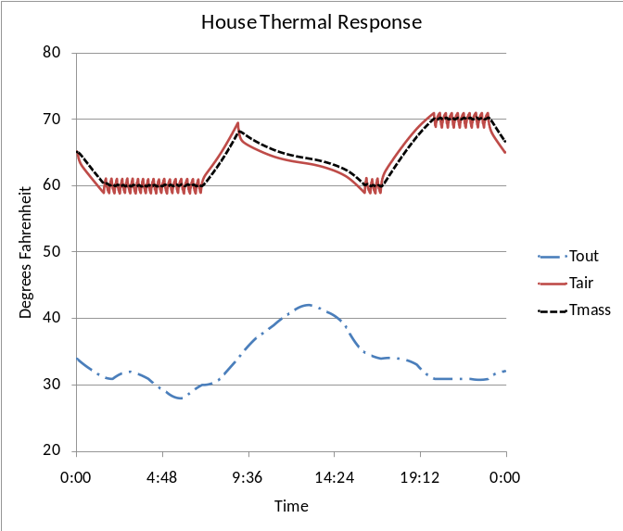
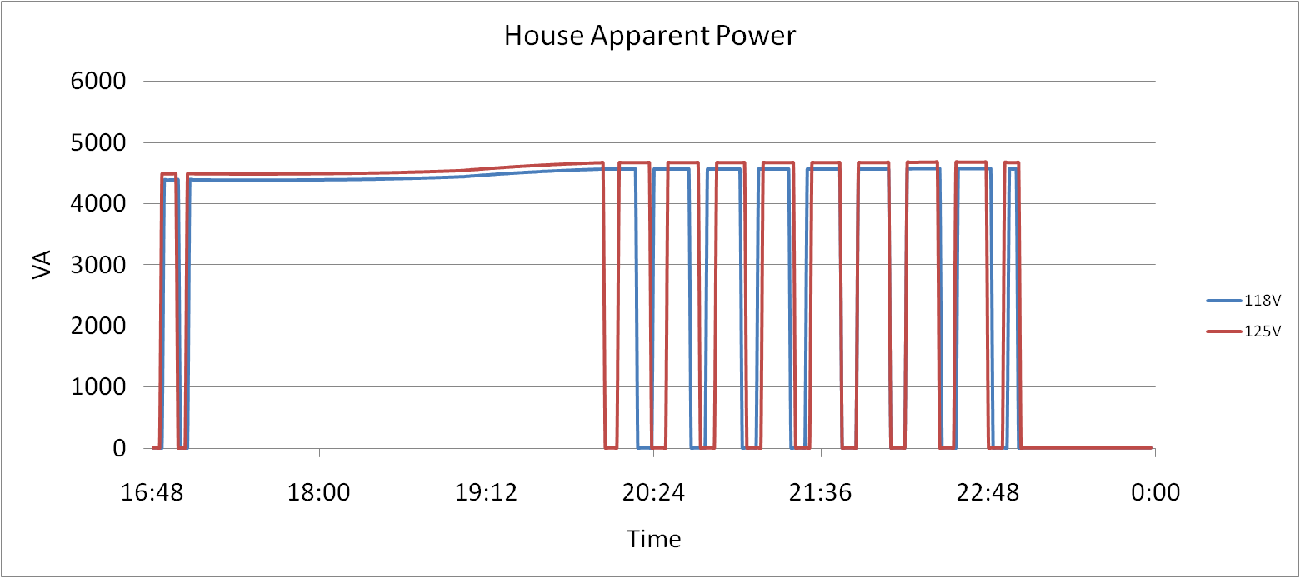
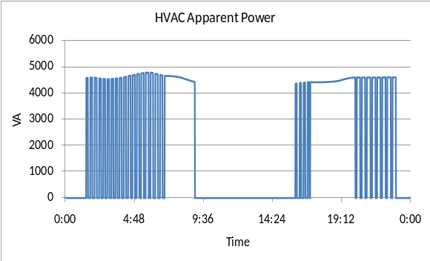
Physical Load Model – Residential HVAC

Slide 34
Multi-State Physical Load Models
Multi-state models as the name implies allow for more than one state of operation.
HVAC systems are a good example:
  State 1: Off
  State 2: Cooling
  State 3: Heating
  State 4: Auxiliary Heating
Multiple states of operation are necessary for complicated appliances and for the modeling of demand response signals.

Slide 35
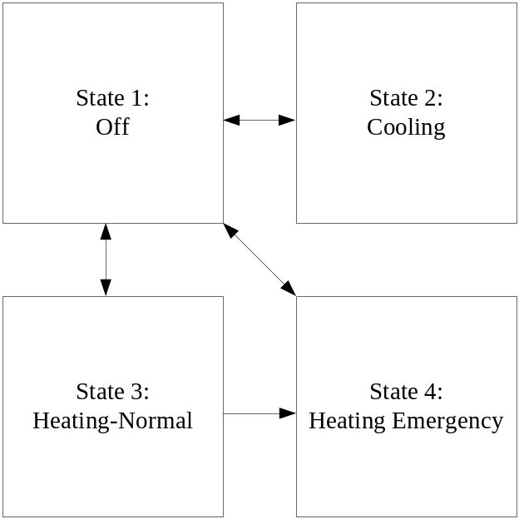
Multi-State Physical Load Models
From State | To State | Transition Rule
1 | 2 | T_{air} > (T_{high} + DB_{high})
1 | 3 | T_{air} < (T_{low} – DB_{low})
1 | 4 | T_{air} < (T_{low} – DB_{low}) & T_{out} < T_{aux}
2 | 1 | T_{air} < (T_{high} – DB_{high})
3 | 1 | T_{air} > (T_{low} + DB_{low})
3 | 4 | T_{out} < T_{aux}
4 | 1 | T_{air} > (T_{low} + DB_{low})

Slide 36
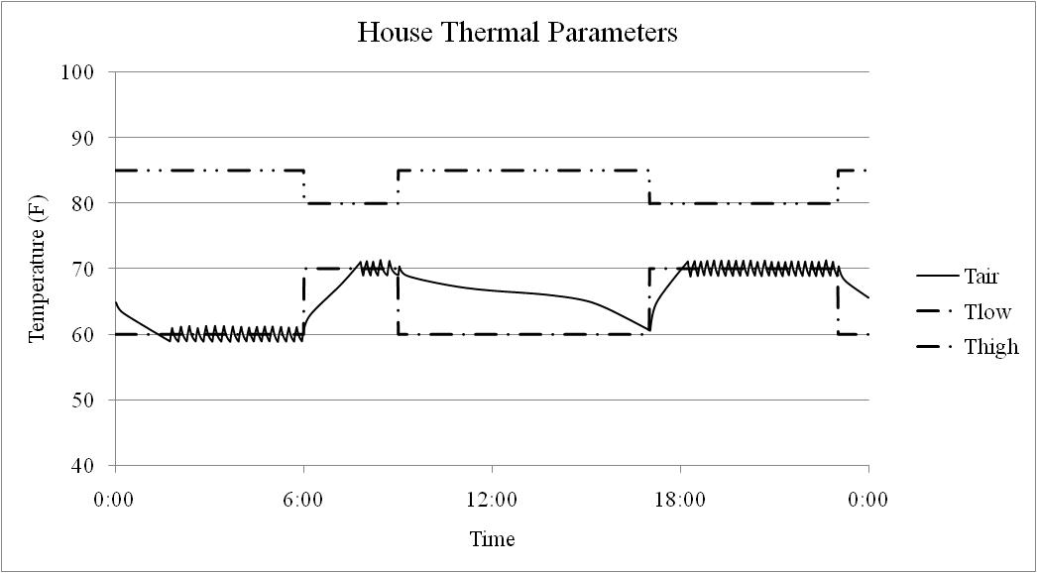
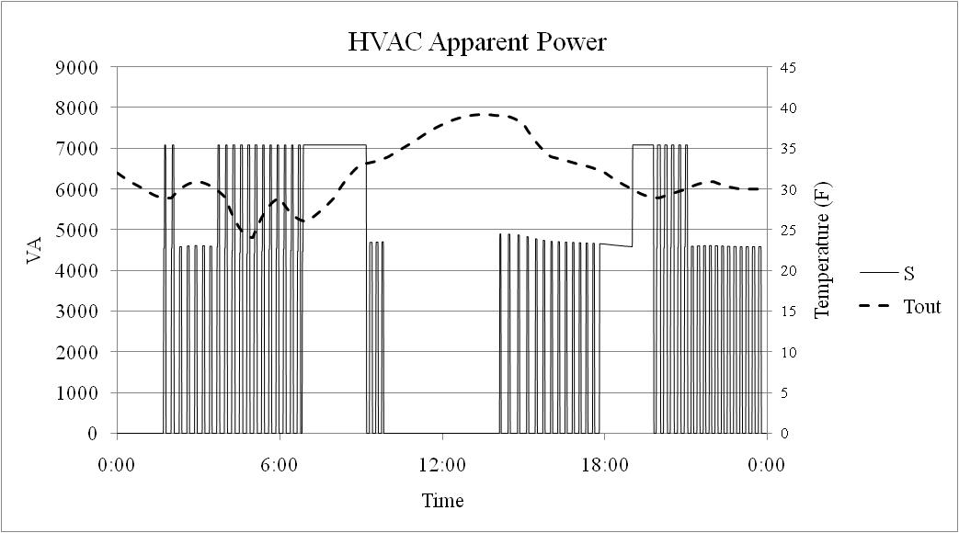
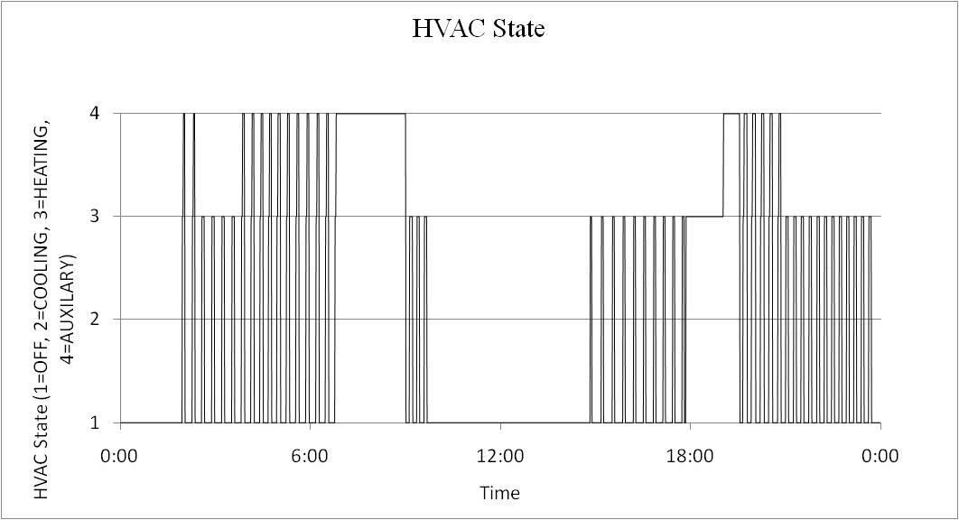
Multi-State Physical Load Models

Slide 37
Part 4: Distribution System Power Flow Solution Methods
The power flow problem: Given the source voltage and end use load, determine the voltage and voltage angle at every node in the system.
Solution Methods
  Forward/Backward Sweep method
    Fast and efficient
    Cannot solve meshed systems
    Fast, efficient, and robust
    Reference: W. H. Kersting, “Distribution System Modeling and Analysis, 2nd Edition”, CRC Press, 2007.
  Newton-Raphson Method
    Requires that the derivative be calculated directly
    Can solve meshed systems
    Requires that the derivative be calculated directly
    Converges quickly for good initial values, otherwise, may fail to converge
    References:
    P. A. N. Garcia, J. L. R. Pereira, S. Carneiro Jr., V. M. Da Costa, and N. Martins, “Three-Phase Power Flow Calculations using the Current Injection Method”, IEEE Transaction on Power Systems, vol. 15, issue 4, pp. 508-514, May 2000.
    Araujo, L.R.; Penido, D.R.R.; Carneiro, S.; Pereira, J.L.R.; Garcia, P.A.N., “A Comparative Study on the Performance of TCIM Full Newton versus Backward-Forward Power Flow Methods for Large Distribution Systems”, in Proc. 2006 IEEE PES Power Systems Conference and Exposition, pp. 522-526.

Slide 38
Forward/Backward Sweep method
Forward/Backward Sweep method is also referred to as a ladder solver.
This was one of the first methods developed for unbalanced power flow.
For radial systems this is a very efficient algorithm.
It is unable to solve on a networked or looped system.
Even though a system is radial, there may be components that present a networked appearance.
Overall this is a very good solution method, but it has limitations.

Slide 39
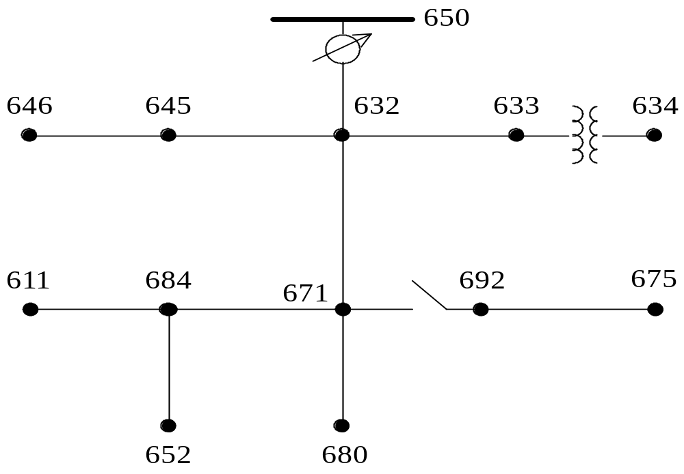
Forward/Backward Sweep Example

Slide 40
Backward Sweep
Starting with an assumed or known voltage calculate the current consumed by each load in the system.
Node 634 load: Phase a: 160 kW 110 kVar
Phase b: 120 kW 90 kVar
Phase c: 120 kW 90 kVar
Assume: Phase V_{a}: 2401+0j
Phase V_{b}: -1200-2080j
Phase V_{c}: -1200+2080j
Give: I=(S/V)*
Yields: I_{a}= 66.6-45.8j
I_{b}= -57.4-24.6j
I_{c}= 7.5+62.0j

Slide 41
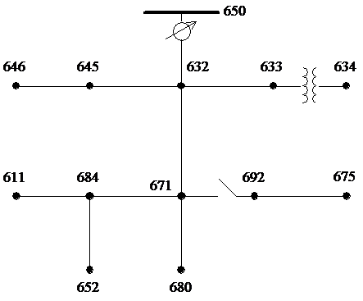
Backward Sweep
Sum the currents at each node in the system until the current at the source is determined.
I_{a}= 66.6-45.8j
I_{b}= -57.4-24.6j
I_{c}= 7.5+62.0j

Slide 42

Forward Sweep
Using the calculated currents determine the voltage drops on each segment.
Since the voltage drop is dependant on the load of the other phases a complete per phase calculation must be used.

Slide 43
Recalculate Load
Based on the new voltages recalculate the new current draw of each load and perform another sweep.

Slide 44
Newton-Raphson Method
Newton-Raphson Methods were originally developed for use on transmission level analysis.
They are based on the power injections at each node, both real and reactive.
These power injections are then used to update the voltage and voltage angle.
The NR method requires the calculation, and inversion of a Jacobian which is computationally intensive.

Slide 45
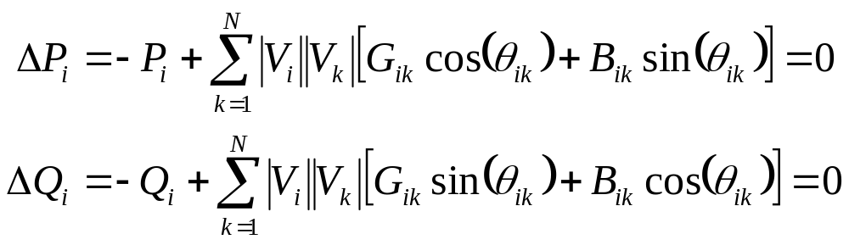
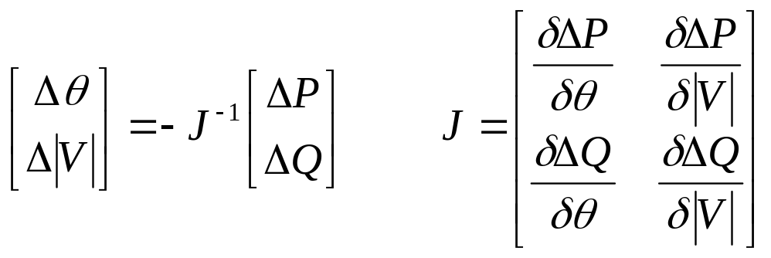
Newton-Raphson Method
P_{i} is the real power injection at node i
Q_{i} is the reactive power injection at node i
G_{ik} is real portion of the admittance between node i and k
B_{ik} is imaginary portion of the admittance between node i and k
V_{i} is the voltage magnitude at node i
δ_{i} is the voltage angle at node i

Slide 46
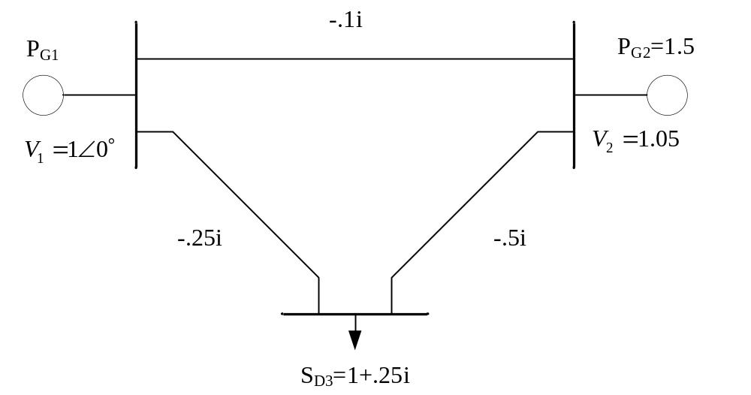
Newton-Raphson Example
(Transmission Level Example)

Slide 47
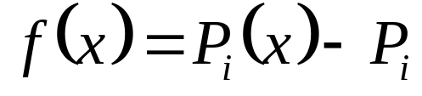
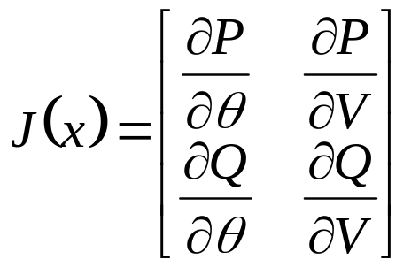
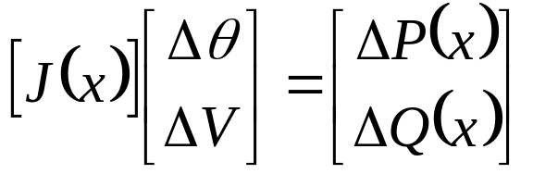
Newton Raphson Procedure

Slide 48
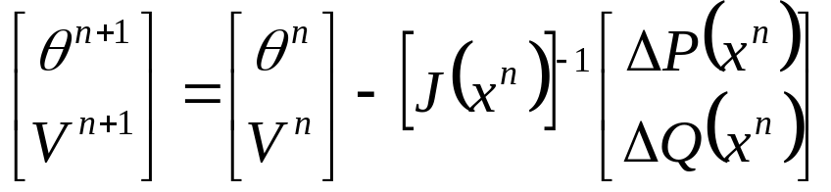
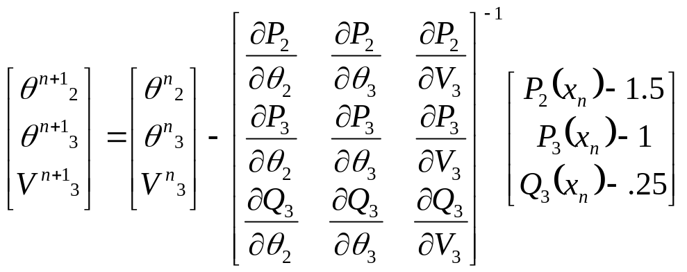
Newton Raphson Procedure

Slide 49
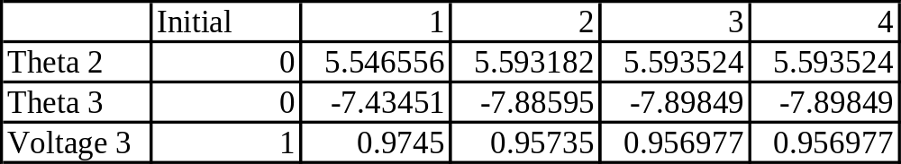
N-R Power Flow Results

Slide 50
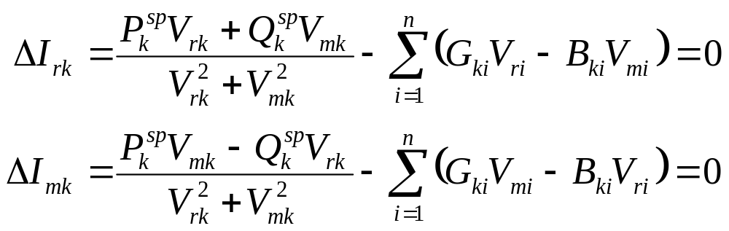
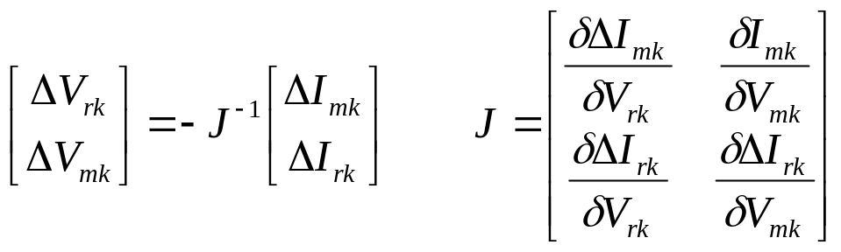
Newton-Raphson Method (TCIM)
In contrast to the traditional NR solver where the voltage and voltage angle are calculated, TCIM calculates the real and reactive components.
The voltage angle can then be calculated from the magnitudes.

Slide 51
Time-series Simulations
Time series simulations are necessary for analysis other than “peak capacity” planning.
Time-series simulations are a series of power flow solutions.
This is not the same as transmission level dynamic or electromagnetic simulations.

Slide 52
Time-series Simulations
State (x)
Δx
Δt
Time (t)

Slide 53
Modified IEEE 13 Node Test System

Slide 54
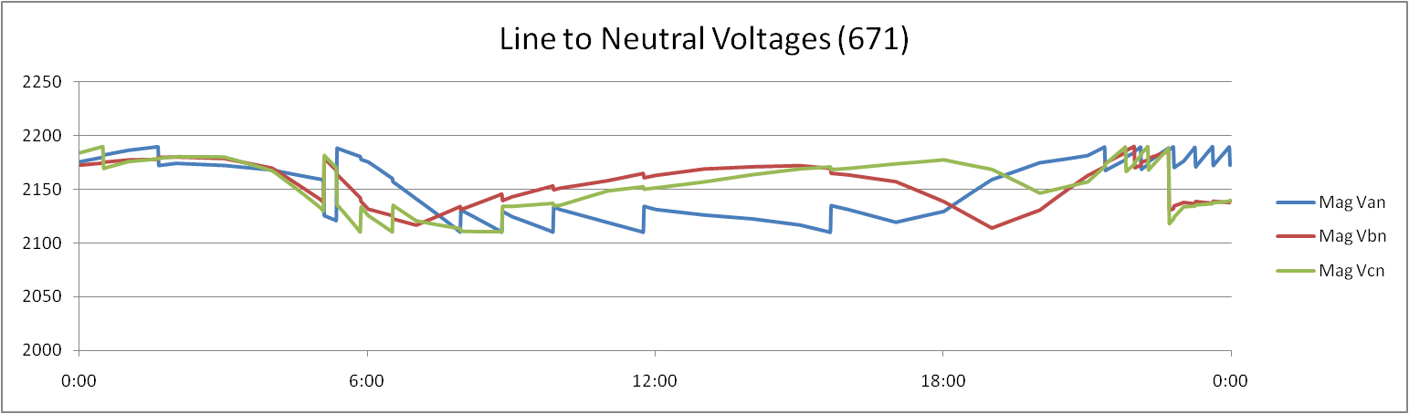
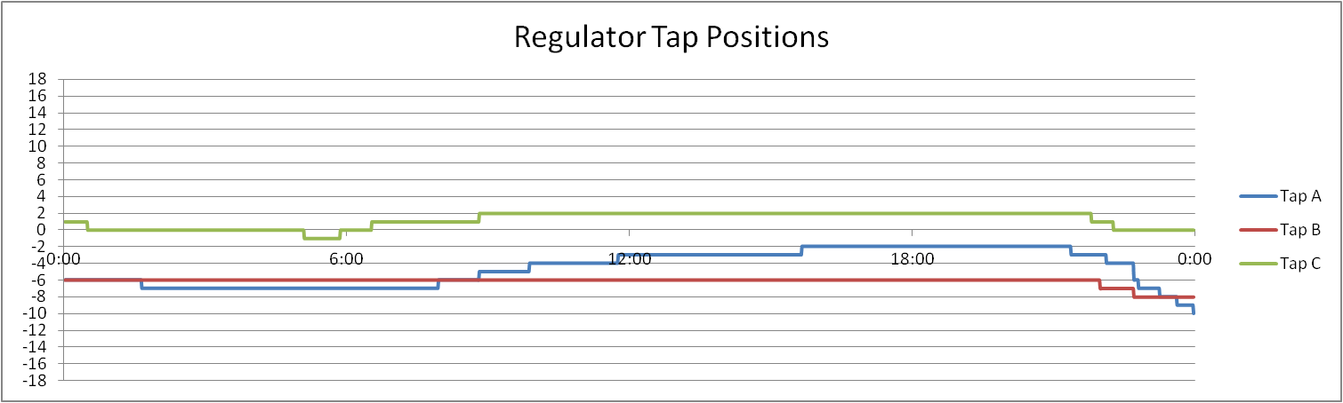
Time-series Simulations (II)

Slide 55
How does it work?
The distribution network is handled as a system of nodes and links.
Forward-Backward Sweep (FBS)
  Voltage (nodes) and current (links) are passed along the distribution network in a series of sweeps.
  The sweeps are repeated for each time step until the system converges with zero voltage “error”.
Newton-Raphson (NR)
  Admittance matrix is built with link objects and used to calculate node voltages from given current injections.
  Iterations are performed within SuperLU until voltage “error” converges to zero.
  Iterations are performed within GridLAB-D to handle all control algorithms.

Slide 56
Powerflow module directives
module powerflow {
solver_method FBS; //NR; GS is deprecated
default_maximum_voltage_error 1e-6; //Defines convergence criteria
NR_iteration_limit 50; //No. of SuperLU iterations per GLD iter.
NR_superLU_procs 1; //No. of processors used by SuperLU
}
As implemented, FBS is faster.
As implemented, NR handles meshed systems, reconfiguration algorithms, and reliability.
Method to be used depends upon application, but both methods currently work with all objects in powerflow and all other modules (except reconfiguration and reliability).

Slide 57
Objects in Powerflow Module
Two main object types: node and link.
Most objects inherit properties from node and link.
Other objects are used to specify different configurations that may be used multiple times
  line_configuration
  line_spacing
  transformer_configuration
  regulator_configuration

Slide 58
Objects in Powerflow Module
The FBS power flow calculation is done at the level of node objects and link objects.
Node Objects
  Capacitor
  Load
  Meter/triplex_meter
  PQLoad
  Substation
  Billdump
  Voltdump
  Motor (in development)
  Frequency_gen
  Volt_var_control
  Currdump
  Emissions
Link Objects
  Fuse
  Switch_object
  Relay
  Recloser
  Sectionalizer
  Overhead_line
  Underground_line
  Triplex_line
  Series Reactor
  Regulator
  Transformer

Slide 59
Objects in powerflow Module
object node {
complex voltage_A[V]; //Used to initialize voltage solution
complex voltage_B[V]; // then tracks voltage over time
complex voltage_C[V];
complex voltage_AB[V]; //Delta voltage connections
complex voltage_BC[V];
complex voltage_CA[V];
complex current_A[A];
complex current_B[A];
complex current_C[A];
complex power_A[W];
complex power_B[W];
complex power_C[W];
complex shunt_A[S];
complex shunt_B[S];
complex shunt_C[S];
string phases; //A,B,C,D, or S
enum bustype; //PQ (default), PV, SWING
double maximum_voltage_error;
}

Slide 60
Objects in powerflow Module
object load {
/*in addition to inherited properties from node object*/
complex constant_power_A[VA];
complex constant_power_B[VA];
complex constant_power_C[VA];
complex constant_current_A[A];
complex constant_current_B[A];
complex constant_current_C[A];
complex constant_impedance_A[Ohm];
complex constant_impedance_B[Ohm];
complex constant_impedance_C[Ohm];
}
May be used to define load classes (residential/industrial/commercial/agricultural)

Slide 61
Objects in powerflow Module
object meter {
/*in addition to inherited properties from node object*/
double measured_real_energy[Wh];
double measured_reactive_energy[Vah];
complex measured_power[VA]; // Also measured_power_A, _B, _C
double measured_real_power[W];
double measured_reactive_power[W];
complex measured_voltage_A[V];
complex measured_voltage_B[V];
complex measured_voltage_C[V];
complex measured_current_A[A];
complex measured_current_B[A];
complex measured_current_C[A];
}
The meters are the interaction point between the powerflow module and the commercial and generator modules (often used on loads)

Slide 62
Objects in powerflow Module
object triplex_meter {
/*in addition to inherited properties from node object*/
double measured_energy[Wh];
double measured_power[W];
double measured_real_power[W];
double measured_reactive_power[W];
complex measured_voltage_1[V];
complex measured_voltage_2[V];
complex measured_voltage_N[V];
complex measured_current_1[A];
complex measured_current_2[A];
complex measured_current_N[A];
}
The triplex meters are the interaction point between the powerflow module and the residential module.
Billing information may also be extracted using bill_mode.

Slide 63
Objects in powerflow Module
object overhead_line {
/* inherited from link objects */
string name;
string phases; //A,B,C,D, or S
object from;
object to;
/* Specific to line objects */
double length[ft];
object configuration;
}
unlike node objects, there is no “generic” link object
underground_line and triplex_line follow the same format
“to” and “from” define the two nodes that the link connects
configuration is defined by a separate object
configuration and length determine all relevant matrices for powerflow calculations

Slide 64
Objects in powerflow Module
object line_configuration {
complex z11 0.45755107+1.07803450j;
complex z12 0.15595008+0.50247120j;
complex z22 0.46662760+1.04816342j;
complex z13 0.15348432+0.38493375j;
complex z23 0.15800624+0.42364872j;
complex z33 0.46147200+1.06505784j;
}
All lines may be specified directly using a z-matrix
User beware in this configuration, as rigorous testing is not performed by the system to determine feasibility

Slide 65
Objects in powerflow Module
object transformer {
/* inherited from link object */
object from;
object to;
double power_in[W];
double power_out[W];
object configuration;
}
Specific transformer parameters defined by transformer_configuration
There are multiple transformer types

Slide 66
Objects in powerflow Module
object transformer_configuration {
enumeration connection_type;
enumeration install_type;
… continued
}
Connection types
  WYE_WYE
  DELTA_DELTA
  DELTA_GWYE
  SINGLE_PHASE
  SINGLE_PHASE_CENTER_TAPPED
Install types
  POLETOP
  PADMOUNT
  VAULT

Slide 67
Objects in powerflow Module
object transformer_configuration {
… continued
double primary_voltage[V];
double secondary_voltage[V];
double power_rating[kVA];
double power_rating_A[kVA];
double power_rating_B[kVA];
double power_rating_C[kVA];
double resistance[pu.Ohm];
double reactance[pu.Ohm];
complex impedance[pu.Ohm];
complex impedance1[pu.Ohm]; // Used in center taps to individually
complex impedance2[pu.Ohm]; // specify each phase impedance.
complex shunt_impedance[pu.Ohm]; // Used in center tap and wye-wye
// to specify shunt losses
}

Slide 68
Objects in powerflow Module
object regulator {
/* inherited from link object*/
object configuration;
int16 tap_A;
int16 tap_B;
int16 tap_C;
object sense_node;
}
Specific regulator parameters defined by regulator_configuration, similar to transformer_configuration
tap_A et. al. are used to specify initial tap positions or manual control
sense_node is used only in specific modes that use remote locations to specify to controlled voltage

Slide 69
Objects in powerflow Module
object regulator_configuration {
enumeration connect_type; //WYE_WYE is the only operational type at this time
double band_center[V];
double band_width[V];
double time_delay[s];
double dwell_time[s];
double raise_taps;
double lower_taps;
double current_transducer_ratio[pu]; // ↓ Used in line drop compensation
double power_transducer_ratio[pu];
double compensator_r_setting_A[V];
double compensator_r_setting_B[V];
double compensator_r_setting_C[V];
double compensator_x_setting_A[V];
double compensator_x_setting_B[V];
double compensator_x_setting_C[V]; // ↑Used in line drop compensation mode
string CT_phase;
string PT_phase;
double regulation;
enumeration control; //MANUAL, OUTPUT_VOLTAGE, LINE_DROP_COMP, or REMOTE_NODE
enumeration type; //A or B
enumeration control_level; //INDIVIDUAL or BANK
int tap_pos_A;
int tap_pos_B;
int tap_pos_C;
}

Slide 70
Node-to-Node Connection
Connected via a link object
  object overhead_line {
  name ovl_12;
  phases "ABCD";
  from node_1; //Can be specified using id #, or by the “name” of the object
  to node_2;
  length 2000;
  configuration line_configuration_300;
  }
Connected via parent/child relationship (length = 0)
  object node {
  name node_2;
  phases "ABCD";
  parent node_1;
  }

Slide 71
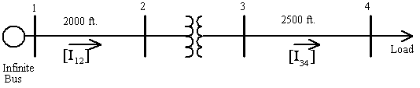
Feeder Example
IEEE 4 Node Feeder
It is looked at as a system of nodes and links
Use FBS and NR method to solve
  Compare the solutions

Slide 72
Powerflow Output
Three phase voltage at each node, including inherited objects
Power in and out and current in and out on each phase at each link, including inherited objects
Additional information available for specific objects, such as tap position or switch settings
Log of events (KML if specified)

Slide 73
Sample Static Powerflow Output
Load object: (node)
Transformer object: (link)
Name | constant_power_A | constant_power_B | constant_power_C | voltage_A | voltage_B | voltage_C
(load_11) (#11) | 1.8e+006+871780j W | 1.8e+006+871780j W | 1.8e+006+871780j W | 1918.94-271.698j V | -1266.24-1576.4j V | -697.555+1873.95j V
Name | configuration | status | From | to | power_in | power_out | phases
(transformer_8) (#8) | transformer_config_4 | CLOSED | node7 | node9 | +7.17672e+006 W | +6.81855e+006 W | ABCD

Slide 74
Time-Series Powerflow Output
With a time-series simulation there are numerous solutions sets, one for each time step.
Examining these as a series of .xml files is not practical, an annual simulation with a 1 minute time step will yield 525,600 solutions.
Instead, “recorders” are used output values to .csv files.
These can then be post processed or plotted.

Slide 75
Exercise 4.1
Load one IEEE 4-node test feeder, run it, and have a look at the output file.
Run the feeder with different transformer configurations and notice the effects.

Slide 76
Exercise 4.2
Load the IEEE 37-node test feeder, which will be used in other exercises.
There is a missing line. Find the missing line and fix the model to include the line.
Replace this line with a Delta-Delta transformer.
Connect an additional load via a node-to-node connection (e.g., without a link object).

Slide 77
Exercise 4.3
Load the IEEE 13-node test feeder, with building loads already attached.
Examine the interface between the powerflow module and the residential module at the triplex meter objects.

